Slide 1
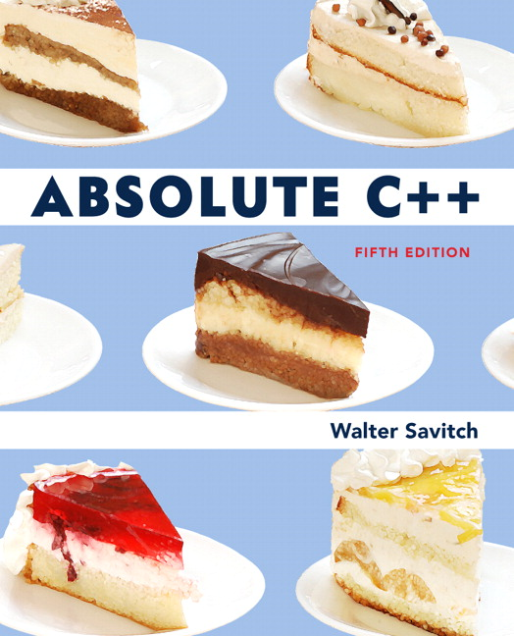
Chapter 7
Constructors and Other Tools

Slide 2
Learning Objectives
Constructors
  Definitions
  Calling
More Tools
  const parameter modifier
  Inline functions
  Static member data
Vectors
  Introduction to vector class
Copyright © 2012 Pearson Addison-Wesley. All rights reserved.
7-<number>

Slide 3
Constructors
Initialization of objects
  Initialize some or all member variables
  Other actions possible as well
A special kind of member function
  Automatically called when object declared
Very useful tool
  Key principle of OOP
Copyright © 2012 Pearson Addison-Wesley. All rights reserved.
7-<number>

Slide 4
Constructor Definitions
Constructors defined like any
member function
  Except:
    Must have same name as class
    Cannot return a value; not even void!
Copyright © 2012 Pearson Addison-Wesley. All rights reserved.
7-<number>

Slide 5
Constructor Definition Example
Class definition with constructor:
  class DayOfYear
  {
  public:
  DayOfYear(int monthValue, int dayValue);
  //Constructor initializes month and day
  void input();
  void output();
  …
  private:
  int month;
  int day;
  }
Copyright © 2012 Pearson Addison-Wesley. All rights reserved.
7-<number>

Slide 6
Constructor Notes
Notice name of constructor: DayOfYear
  Same name as class itself!
Constructor declaration has no return-type
  Not even void!
Constructor in public section
  It’s called when objects are declared
  If private, could never declare objects!
Copyright © 2012 Pearson Addison-Wesley. All rights reserved.
7-<number>

Slide 7
Calling Constructors
Declare objects:
DayOfYear date1(7, 4),
date2(5, 5);
Objects are created here
  Constructor is called
  Values in parens passed as arguments
  to constructor
  Member variables month, day initialized:
  date1.month → 7 date2.month → 5
  date1.dat → 4 date2.day → 5
Copyright © 2012 Pearson Addison-Wesley. All rights reserved.
7-<number>

Slide 8
Constructor Equivalency
Consider:
  DayOfYear date1, date2
  date1.DayOfYear(7, 4); // ILLEGAL!
  date2.DayOfYear(5, 5); // ILLEGAL!
Seemingly OK…
  CANNOT call constructors like other member functions!
Copyright © 2012 Pearson Addison-Wesley. All rights reserved.
7-<number>

Slide 9
Constructor Code
Constructor definition is like all other
member functions:
DayOfYear::DayOfYear(int monthValue, int dayValue)
{
month = monthValue;
day = dayValue;
}
Note same name around ::
  Clearly identifies a constructor
Note no return type
  Just as in class definition
Copyright © 2012 Pearson Addison-Wesley. All rights reserved.
7-<number>

Slide 10
Alternative Definition
Previous definition equivalent to:
DayOfYear::DayOfYear( int monthValue,
int dayValue)
: month(monthValue), day(dayValue) ←
{…}
Third line called "Initialization Section"
Body left empty
Preferable definition version
Copyright © 2012 Pearson Addison-Wesley. All rights reserved.
7-<number>

Slide 11
Constructor Additional Purpose
Not just initialize data
Body doesn’t have to be empty
  In initializer version
Validate the data!
  Ensure only appropriate data is assigned to
  class private member variables
  Powerful OOP principle
Copyright © 2012 Pearson Addison-Wesley. All rights reserved.
7-<number>

Slide 12
Overloaded Constructors
Can overload constructors just like
other functions
Recall: a signature consists of:
  Name of function
  Parameter list
Provide constructors for all possible
argument-lists
  Particularly "how many"
Copyright © 2012 Pearson Addison-Wesley. All rights reserved.
7-<number>

Slide 13
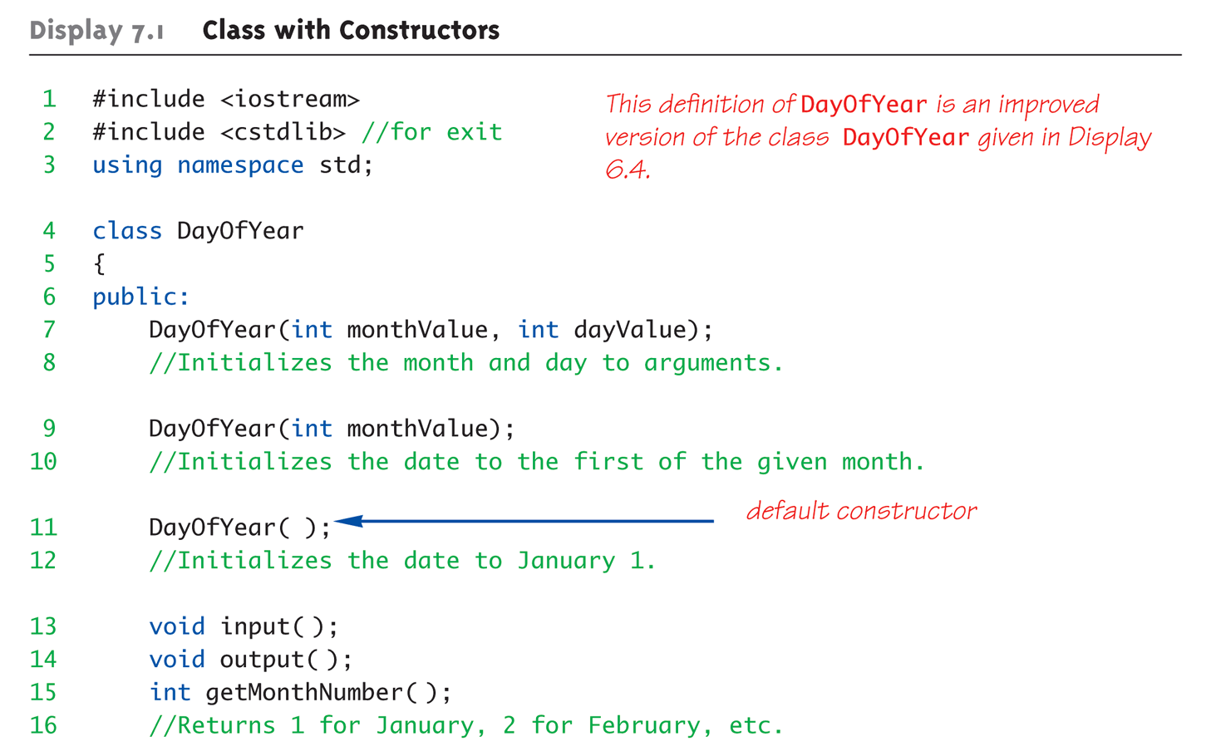
Class with Constructors Example:
Display 7.1 Class with Constructors (1 of 3)
Copyright © 2012 Pearson Addison-Wesley. All rights reserved.
7-<number>

Slide 14
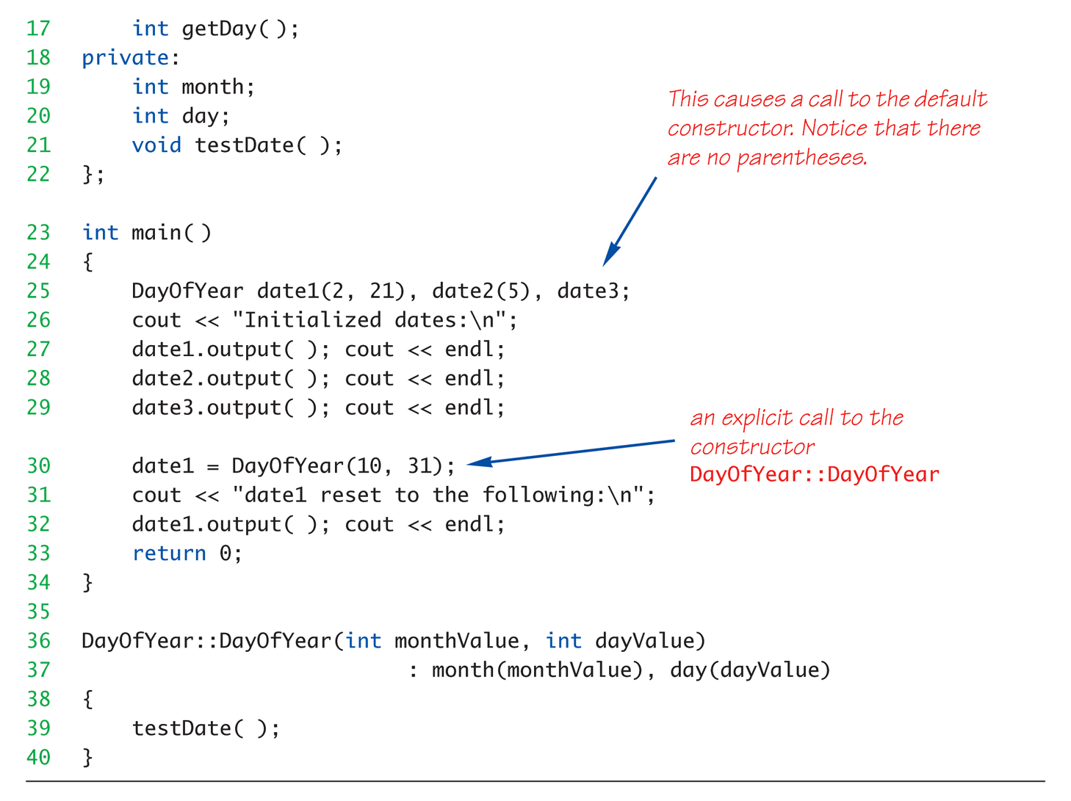
Class with Constructors Example:
Display 7.1 Class with Constructors (2 of 3)
Copyright © 2012 Pearson Addison-Wesley. All rights reserved.
7-<number>

Slide 15
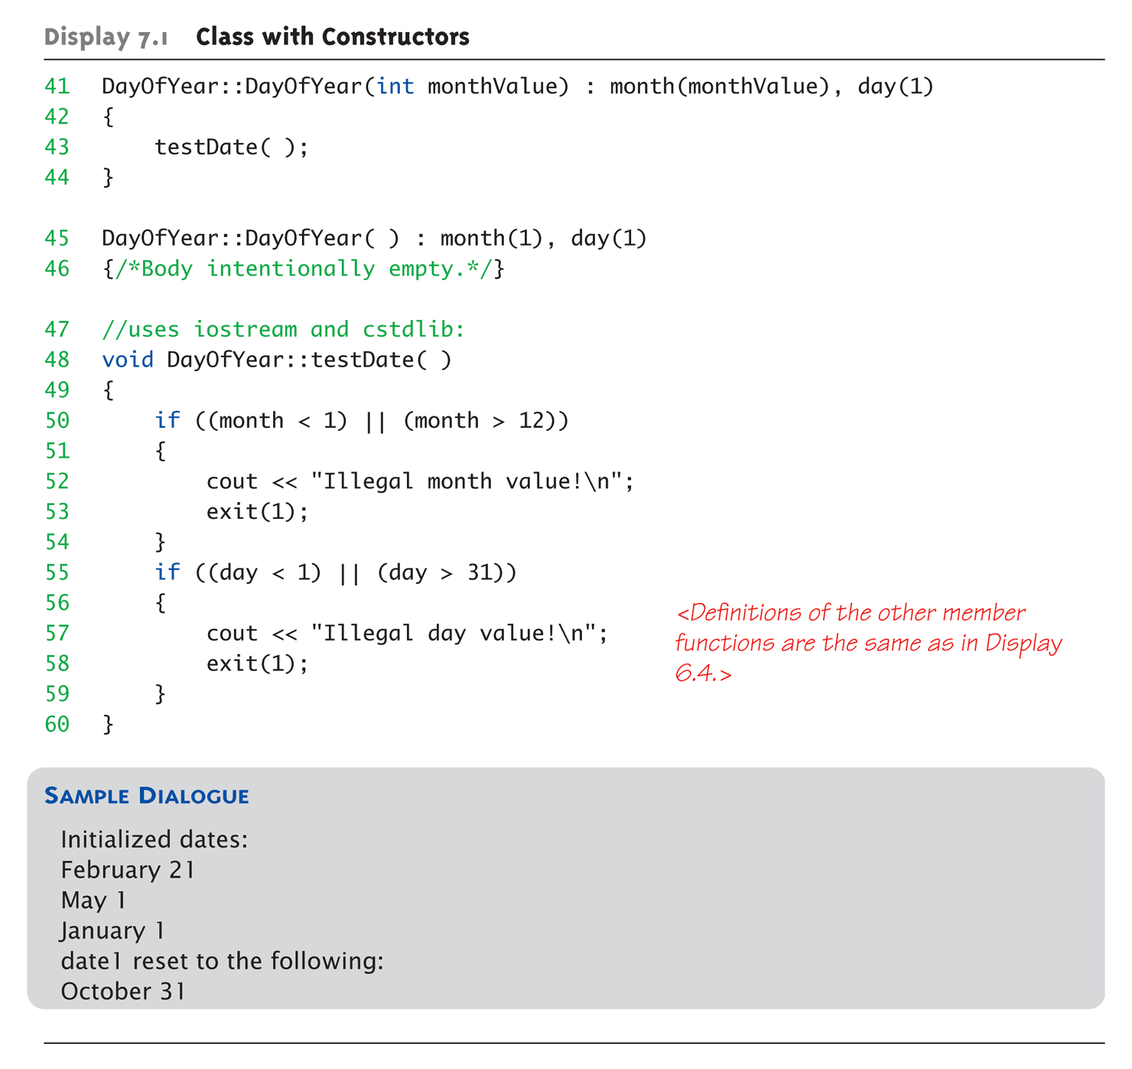
Class with Constructors Example:
Display 7.1 Class with Constructors (3 of 3)
Copyright © 2012 Pearson Addison-Wesley. All rights reserved.
7-<number>

Slide 16
Constructor with No Arguments
Can be confusing
Standard functions with no arguments:
  Called with syntax: callMyFunction();
    Including empty parentheses
Object declarations with no "initializers":
  DayOfYear date1; // This way!
  DayOfYear date(); // NO!
    What is this really?
    Compiler sees a function declaration/prototype!
    Yes! Look closely!
Copyright © 2012 Pearson Addison-Wesley. All rights reserved.
7-<number>

Slide 17
Explicit Constructor Calls
Can also call constructor AGAIN
  After object declared
    Recall: constructor was automatically called then
  Can call via object’s name; standard member
  function call
Convenient method of setting
member variables
Method quite different from standard
member function call
Copyright © 2012 Pearson Addison-Wesley. All rights reserved.
7-<number>

Slide 18
Explicit Constructor Call Example
Such a call returns "anonymous object"
  Which can then be assigned
  In Action:
  DayOfYear holiday(7, 4);
    Constructor called at object’s declaration
    Now to "re-initialize":
    holiday = DayOfYear(5, 5);
      Explicit constructor call
      Returns new "anonymous object"
      Assigned back to current object
Copyright © 2012 Pearson Addison-Wesley. All rights reserved.
7-<number>

Slide 19
Default Constructor
Defined as: constructor w/ no arguments
One should always be defined
Auto-Generated?
  Yes & No
  If no constructors AT ALL are defined → Yes
  If any constructors are defined → No
If no default constructor:
  Cannot declare: MyClass myObject;
    With no initializers
Copyright © 2012 Pearson Addison-Wesley. All rights reserved.
7-<number>

Slide 20
Class Type Member Variables
Class member variables can be any type
  Including objects of other classes!
  Type of class relationship
    Powerful OOP principle
Need special notation for constructors
  So they can call "back" to member
  object’s constructor
Copyright © 2012 Pearson Addison-Wesley. All rights reserved.
7-<number>

Slide 21
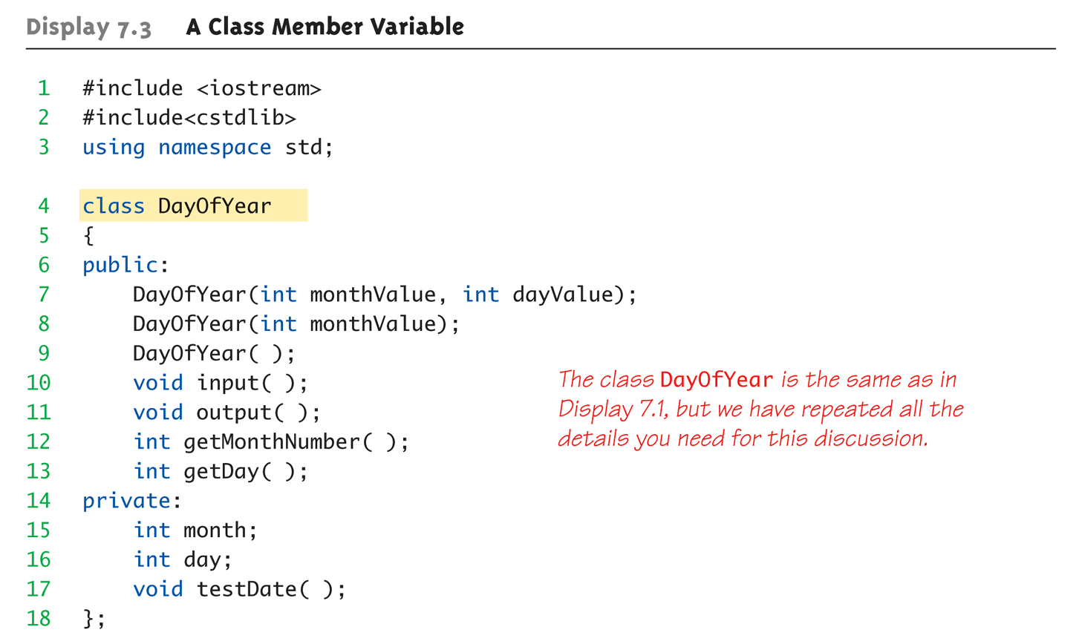
Class Member Variable Example:
Display 7.3 A Class Member Variable (1 of 5)
Copyright © 2012 Pearson Addison-Wesley. All rights reserved.
7-<number>

Slide 22
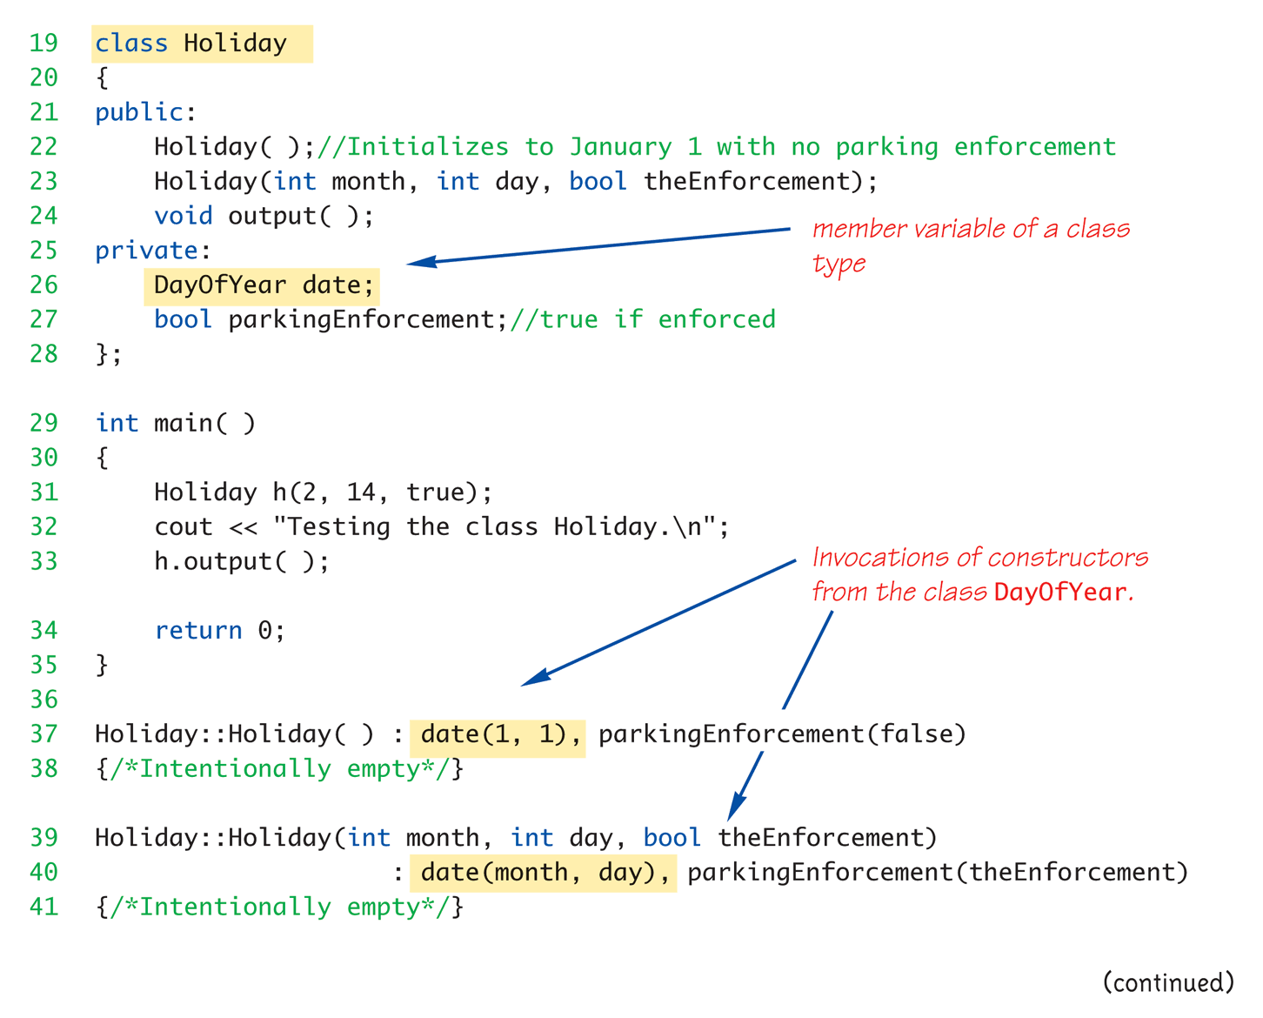
Class Member Variable Example:
Display 7.3 A Class Member Variable (2 of 5)
Copyright © 2012 Pearson Addison-Wesley. All rights reserved.
7-<number>

Slide 23
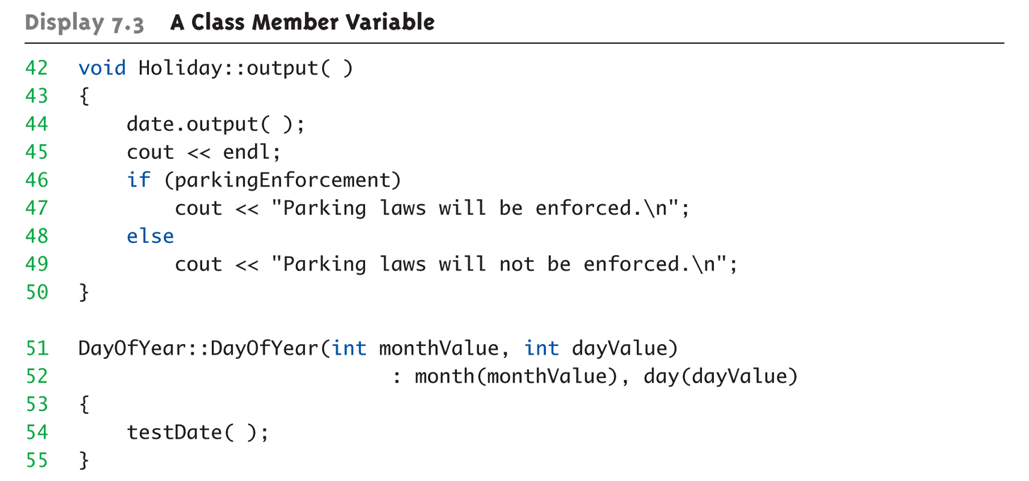
Class Member Variable Example:
Display 7.3 A Class Member Variable (3 of 5)
Copyright © 2012 Pearson Addison-Wesley. All rights reserved.
7-<number>

Slide 24
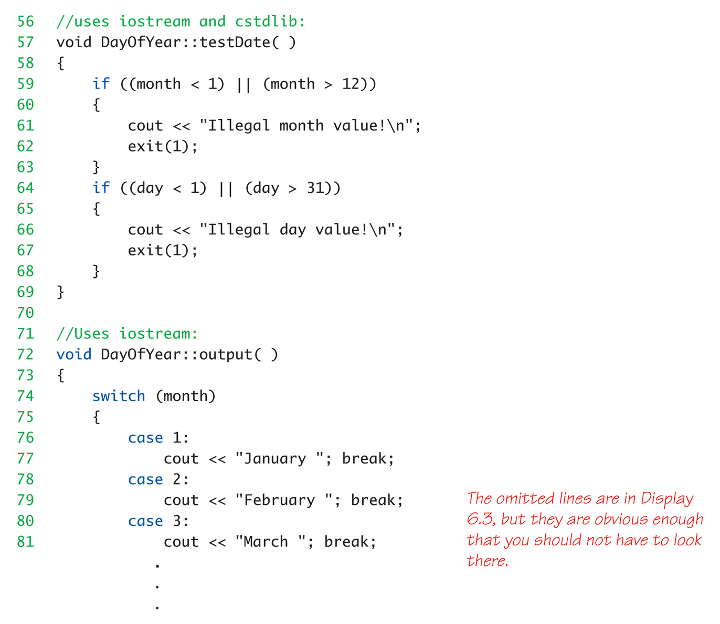
Class Member Variable Example:
Display 7.3 A Class Member Variable (4 of 5)
Copyright © 2012 Pearson Addison-Wesley. All rights reserved.
7-<number>

Slide 25
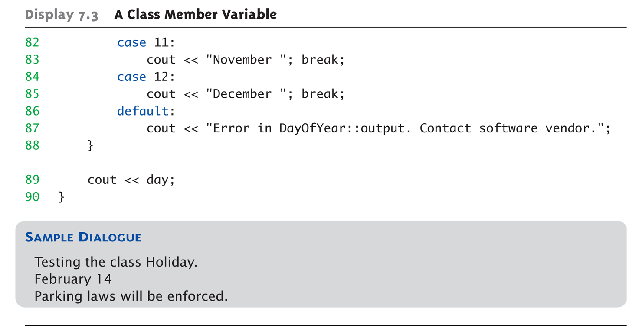
Class Member Variable Example:
Display 7.3 A Class Member Variable (5 of 5)
Copyright © 2012 Pearson Addison-Wesley. All rights reserved.
7-<number>

Slide 26
Parameter Passing Methods
Efficiency of parameter passing
  Call-by-value
    Requires copy be made → Overhead
  Call-by-reference
    Placeholder for actual argument
    Most efficient method
  Negligible difference for simple types
  For class types → clear advantage
Call-by-reference desirable
  Especially for "large" data, like class types
Copyright © 2012 Pearson Addison-Wesley. All rights reserved.
7-<number>

Slide 27
The const Parameter Modifier
Large data types (typically classes)
  Desirable to use pass-by-reference
  Even if function will not make modifications
Protect argument
  Use constant parameter
    Also called constant call-by-reference parameter
  Place keyword const before type
  Makes parameter "read-only"
  Attempt to modify parameter results in compiler error
Copyright © 2012 Pearson Addison-Wesley. All rights reserved.
7-<number>

Slide 28
Use of const
All-or-nothing
If no need for function modifications
  Protect parameter with const
  Protect ALL such parameters
This includes class member function
parameters
Copyright © 2012 Pearson Addison-Wesley. All rights reserved.
7-<number>

Slide 29
Inline Functions
For non-member functions:
  Use keyword inline in function declaration
  and function heading
For class member functions:
  Place implementation (code) for function IN
  class definition → automatically inline
Use for very short functions only
Code actually inserted in place of call
  Eliminates overhead
  More efficient, but only when short!
Copyright © 2012 Pearson Addison-Wesley. All rights reserved.
7-<number>

Slide 30
Inline Member Functions
Member function definitions
  Typically defined separately, in different file
  Can be defined IN class definition
    Makes function "in-line"
Again: use for very short functions only
More efficient
  If too long → actually less efficient!
Copyright © 2012 Pearson Addison-Wesley. All rights reserved.
7-<number>

Slide 31
Static Members
Static member variables
  All objects of class "share" one copy
  One object changes it → all see change
Useful for "tracking"
  How often a member function is called
  How many objects exist at given time
Place keyword static before type
Copyright © 2012 Pearson Addison-Wesley. All rights reserved.
7-<number>

Slide 32
Static Functions
Member functions can be static
  If no access to object data needed
  And still "must" be member of the class
  Make it a static function
Can then be called outside class
  From non-class objects:
    E.g., Server::getTurn();
  As well as via class objects
    Standard method: myObject.getTurn();
Can only use static data, functions!
Copyright © 2012 Pearson Addison-Wesley. All rights reserved.
7-<number>

Slide 33
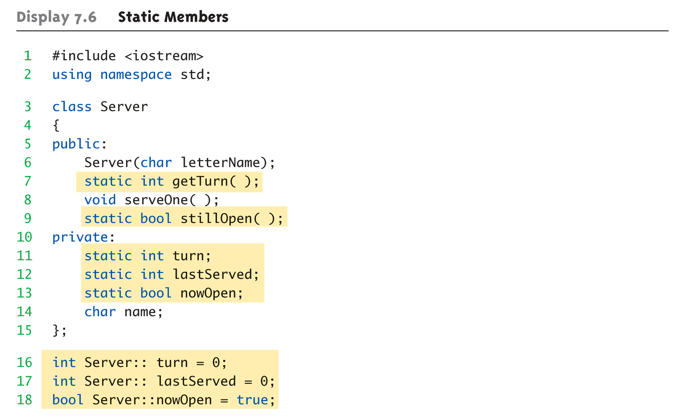
Static Members Example:
Display 7.6 Static Members (1 of 4)
Copyright © 2012 Pearson Addison-Wesley. All rights reserved.
7-<number>

Slide 34
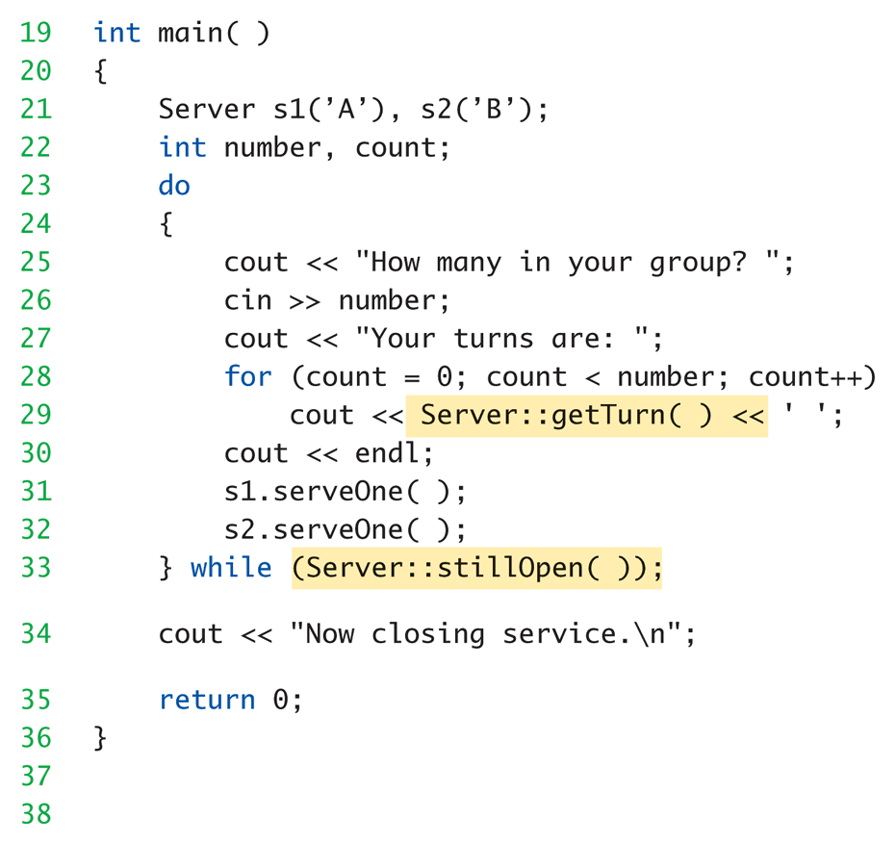
Static Members Example:
Display 7.6 Static Members (2 of 4)
Copyright © 2012 Pearson Addison-Wesley. All rights reserved.
7-<number>

Slide 35
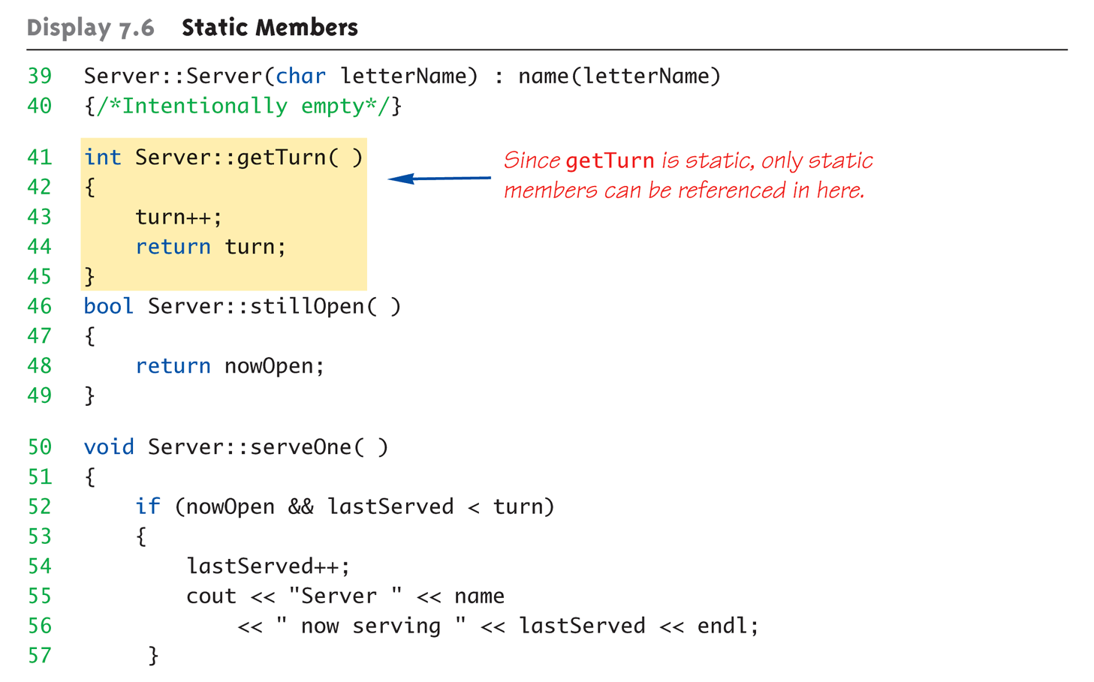
Static Members Example:
Display 7.6 Static Members (3 of 4)
Copyright © 2012 Pearson Addison-Wesley. All rights reserved.
7-<number>

Slide 36
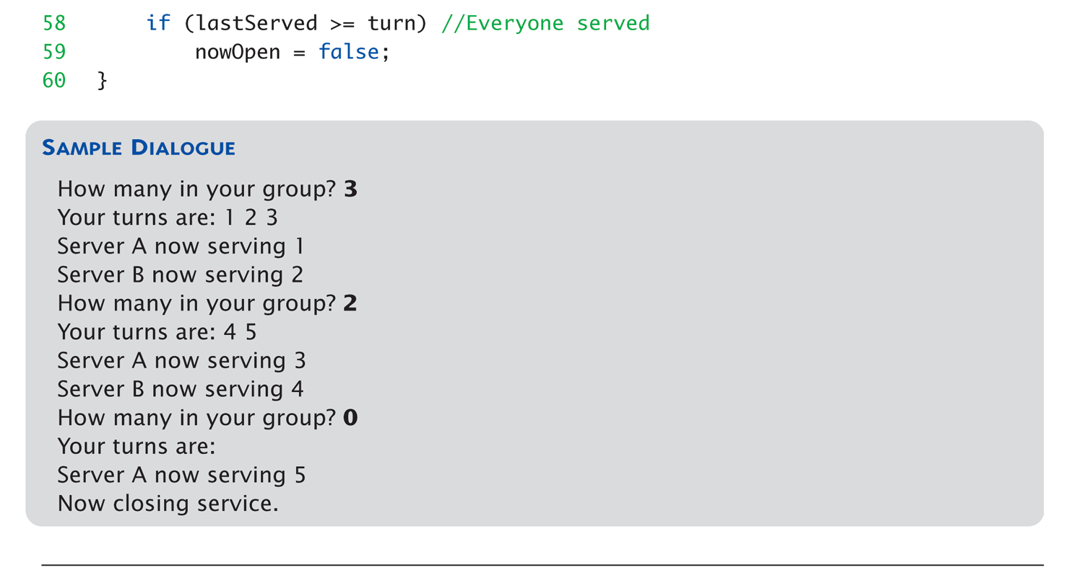
Static Members Example:
Display 7.6 Static Members (4 of 4)
Copyright © 2012 Pearson Addison-Wesley. All rights reserved.
7-<number>

Slide 37
Vectors
Vector Introduction
  Recall: arrays are fixed size
  Vectors: "arrays that grow and shrink"
    During program execution
  Formed from Standard Template Library
  (STL)
    Using template class
Copyright © 2012 Pearson Addison-Wesley. All rights reserved.
7-<number>

Slide 38
Vector Basics
Similar to array:
  Has base type
  Stores collection of base type values
Declared differently:
  Syntax: vector<Base_Type>
    Indicates template class
    Any type can be "plugged in" to Base_Type
    Produces "new" class for vectors with that type
  Example declaration:
  vector<int> v;
Copyright © 2012 Pearson Addison-Wesley. All rights reserved.
7-<number>

Slide 39
Vector Use
vector<int> v;
  "v is vector of type int"
  Calls class default constructor
    Empty vector object created
Indexed like arrays for access
But to add elements:
  Must call member function push_back
Member function size()
  Returns current number of elements
Copyright © 2012 Pearson Addison-Wesley. All rights reserved.
7-<number>

Slide 40
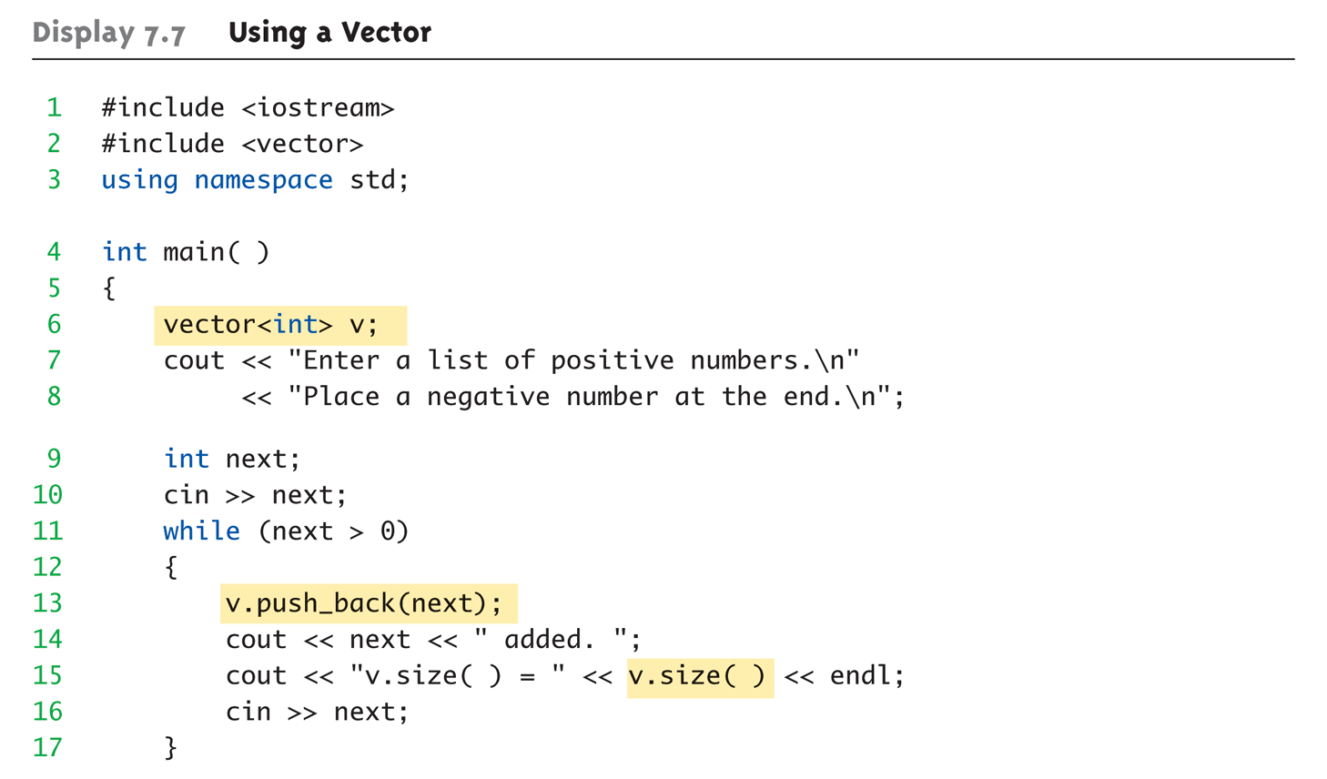
Vector Example:
Display 7.7 Using a Vector (1 of 2)
Copyright © 2012 Pearson Addison-Wesley. All rights reserved.
7-<number>

Slide 41
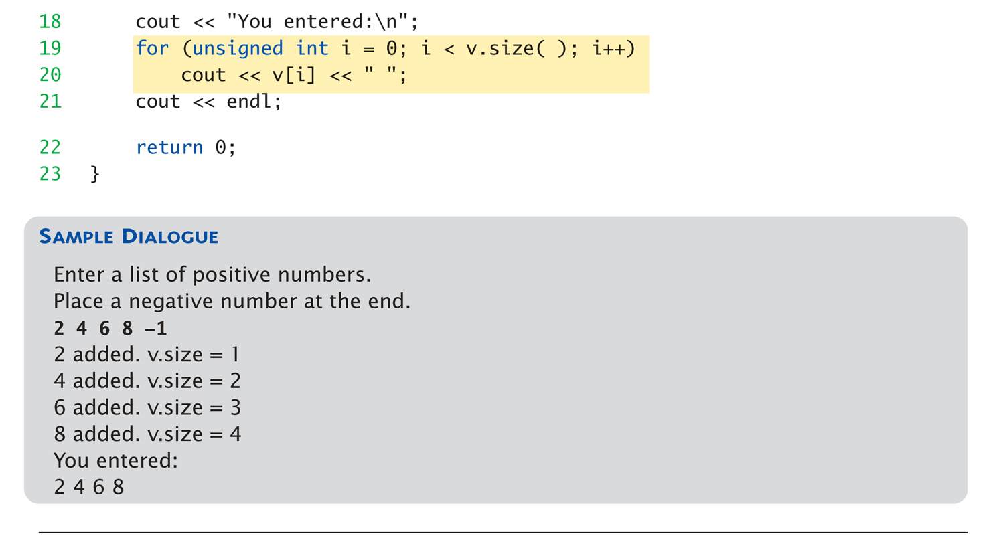
Vector Example:
Display 7.7 Using a Vector (2 of 2)
Copyright © 2012 Pearson Addison-Wesley. All rights reserved.
7-<number>

Slide 42
Vector Efficiency
Member function capacity()
  Returns memory currently allocated
  Not same as size()
  Capacity typically > size
    Automatically increased as needed
If efficiency critical:
  Can set behaviors manually
    v.reserve(32); //sets capacity to 32
    v.reserve(v.size()+10); //sets capacity to 10 more
    than size
Copyright © 2012 Pearson Addison-Wesley. All rights reserved.
7-<number>

Slide 43
Summary 1
Constructors: automatic initialization of
class data
  Called when objects are declared
  Constructor has same name as class
Default constructor has no parameters
  Should always be defined
Class member variables
  Can be objects of other classes
    Require initialization-section
Copyright © 2012 Pearson Addison-Wesley. All rights reserved.
7-<number>

Slide 44
Summary 2
Constant call-by-reference parameters
  More efficient than call-by-value
Can inline very short function definitions
  Can improve efficiency
Static member variables
  Shared by all objects of a class
Vector classes
  Like: "arrays that grow and shrink"
Copyright © 2012 Pearson Addison-Wesley. All rights reserved.
7-<number>

